Slide 1
Rancangan UML Aplikasi pengelolaan perpustakaan
Kelompok 4:
Iman faturahman
Irfan ramdani
Isep Lutpi Nur
Muhamad Rafi Algippari
Razan Aiman Nadir

Slide 2
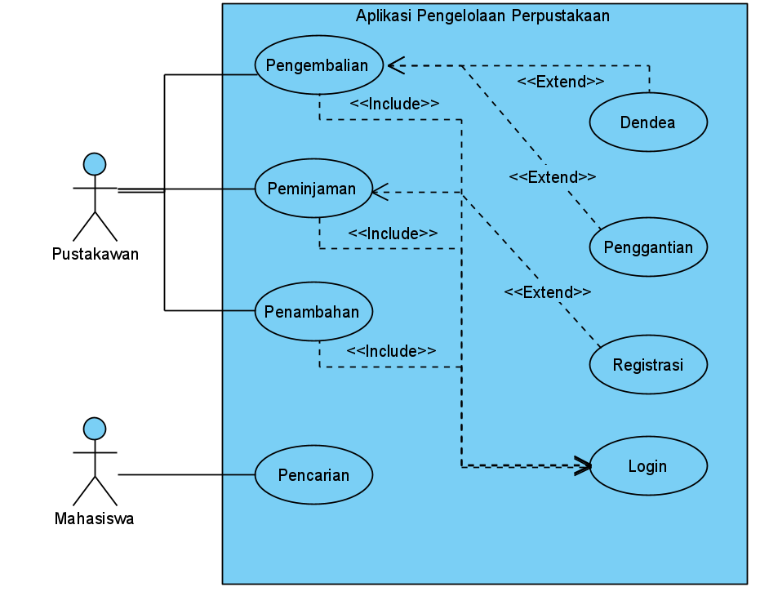
Use Case Diagram

Slide 3
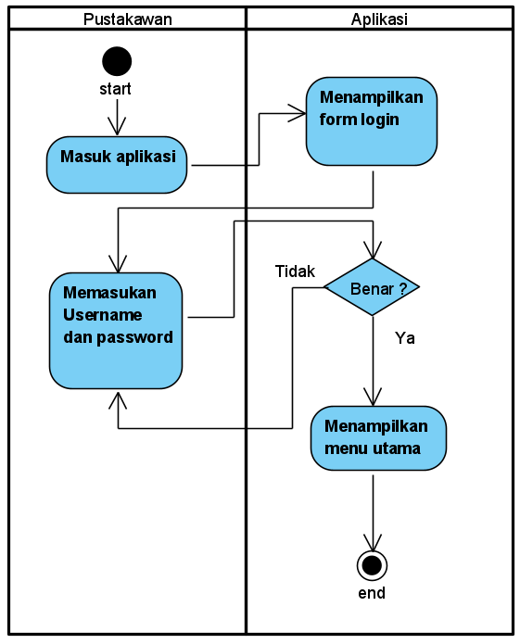
Activity Diagram Login

Slide 4
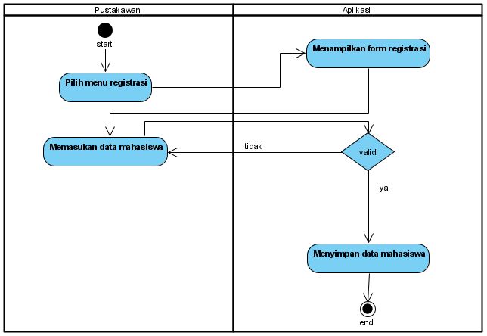
Activity Diagram Registrasi

Slide 5
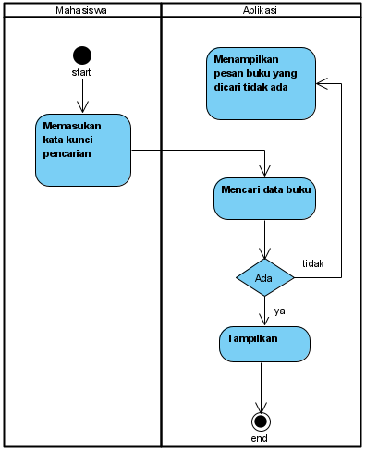
Activity Diagram Pencarian buku

Slide 6
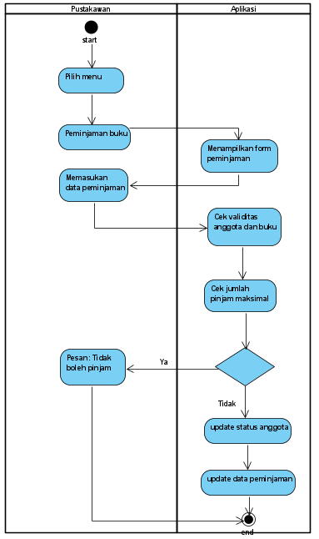
Activity Diagram Peminjaman buku

Slide 7
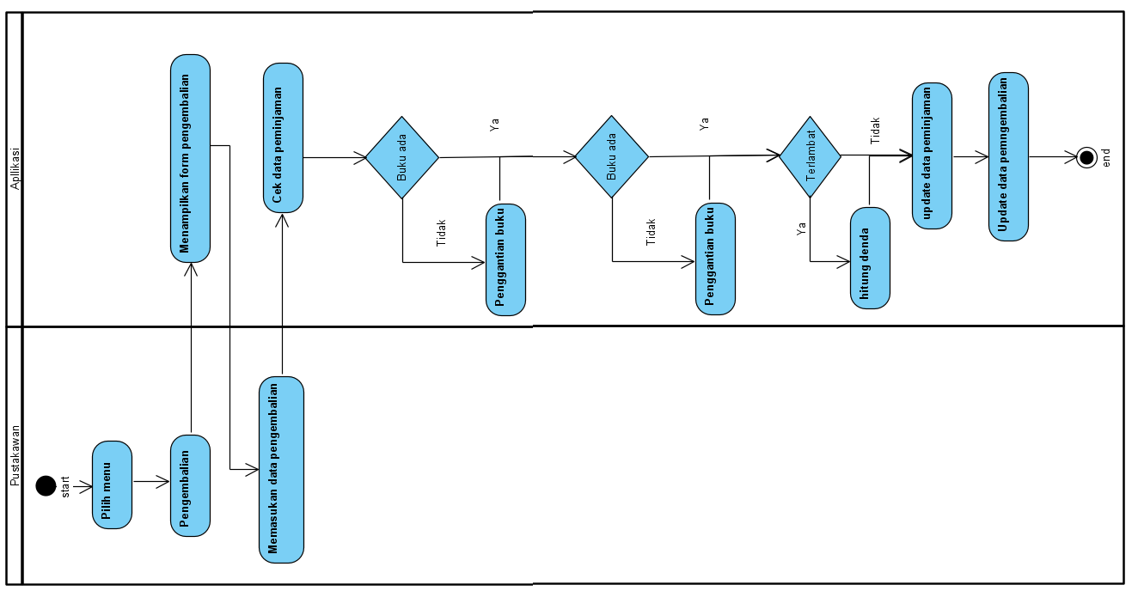
Activity Diagram Pengembalian buku

Slide 8
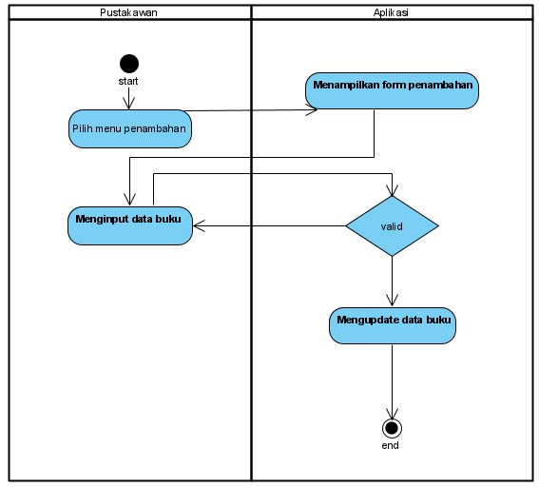
Activity Diagram Penambahan buku

Slide 9
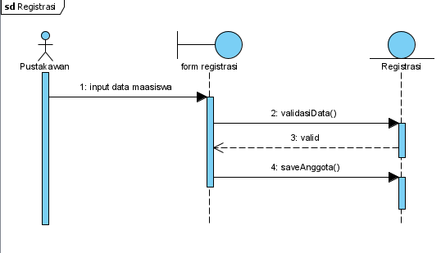
Sequence Diagram Registrasi

Slide 10
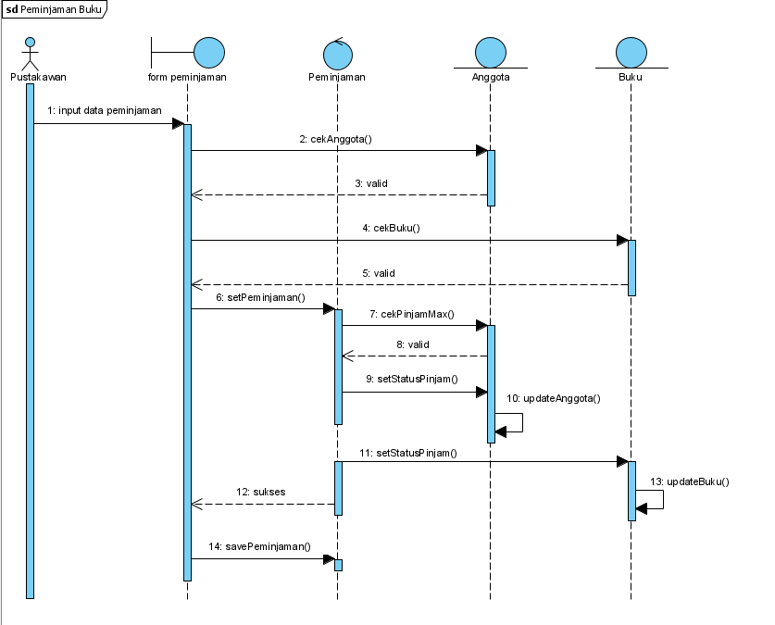
Sequence Diagram Peminjaman buku

Slide 11
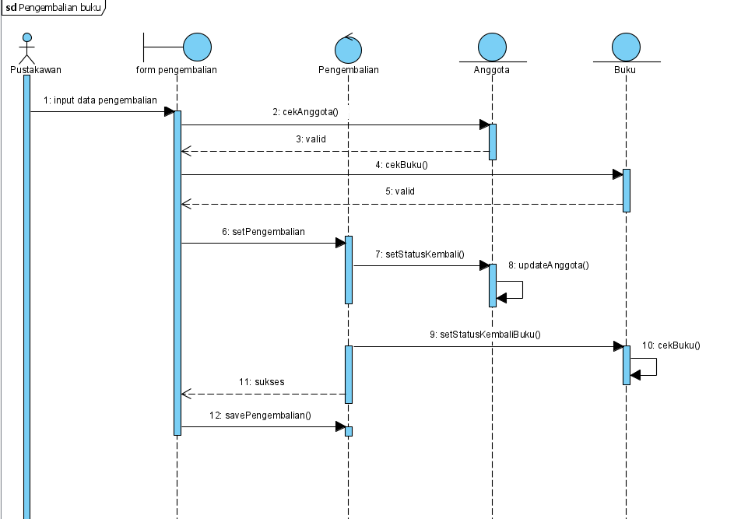
Sequence Diagram Pengembalian buku

Slide 12
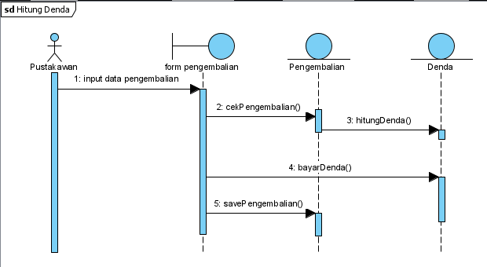
Sequence Diagram Denda

Slide 13
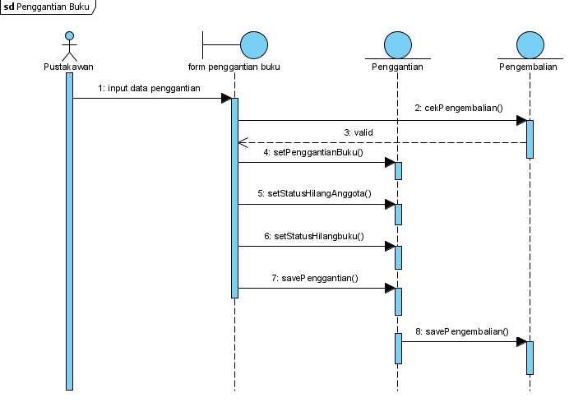
Sequence Diagram Penggantian buku

Slide 14
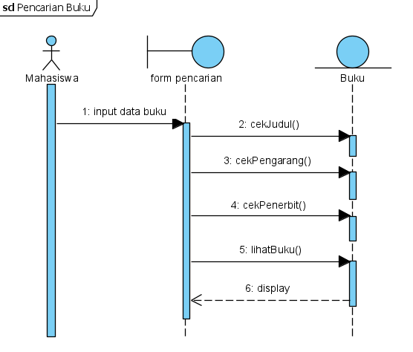
Sequence Diagram Pencarian buku

Slide 15
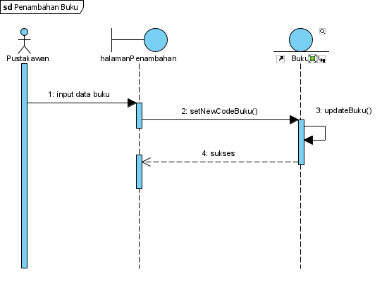
Sequence Diagram Penambahan buku

Slide 16
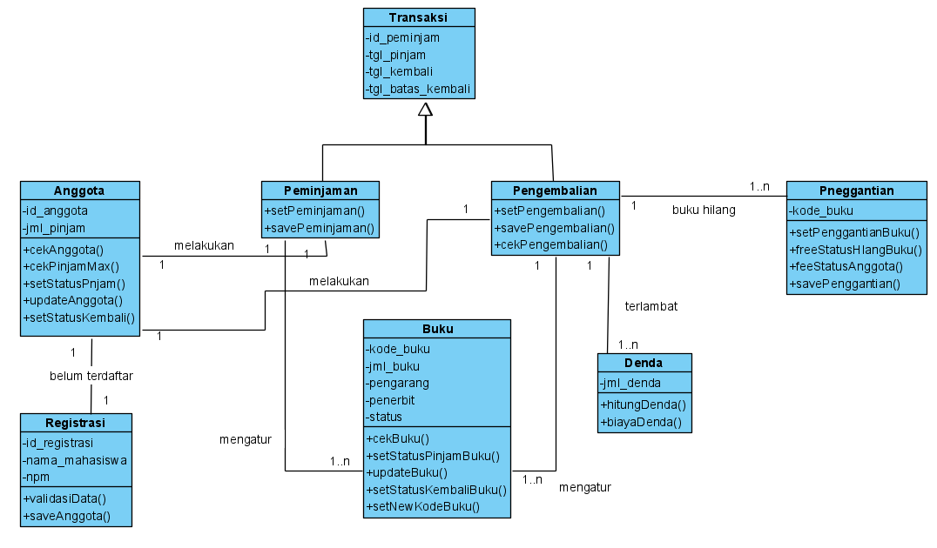
ClassDiagram

Slide 17
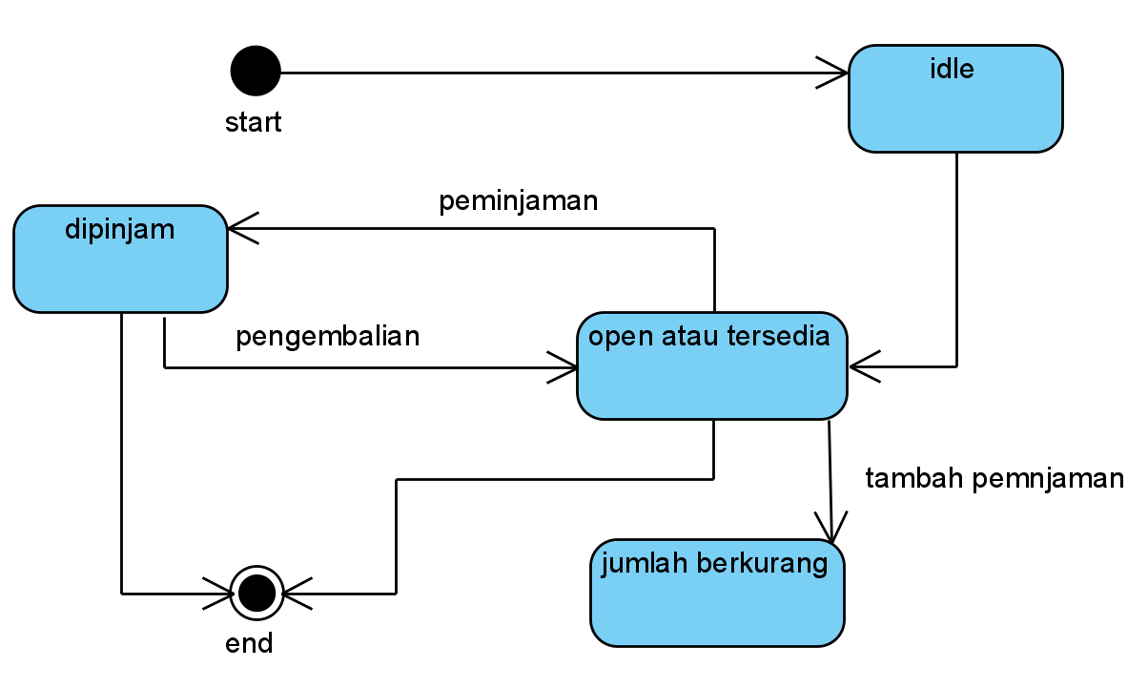
State Machine Diagram Buku

Slide 18
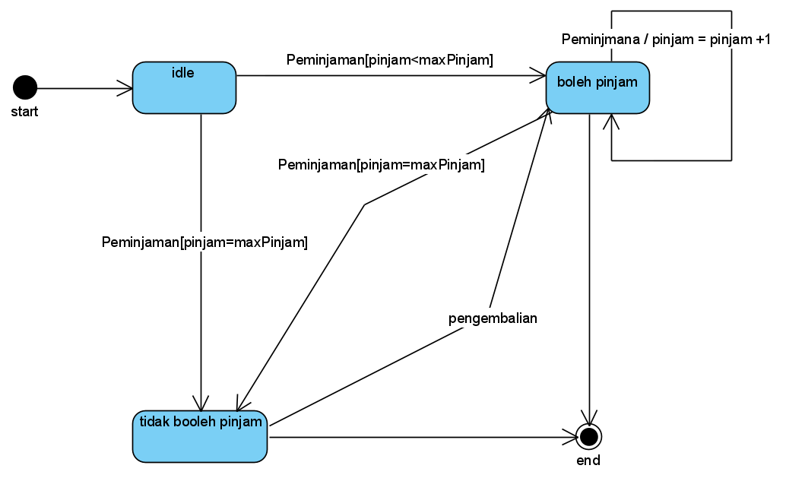
State Machine Diagram Anggota

Slide 19
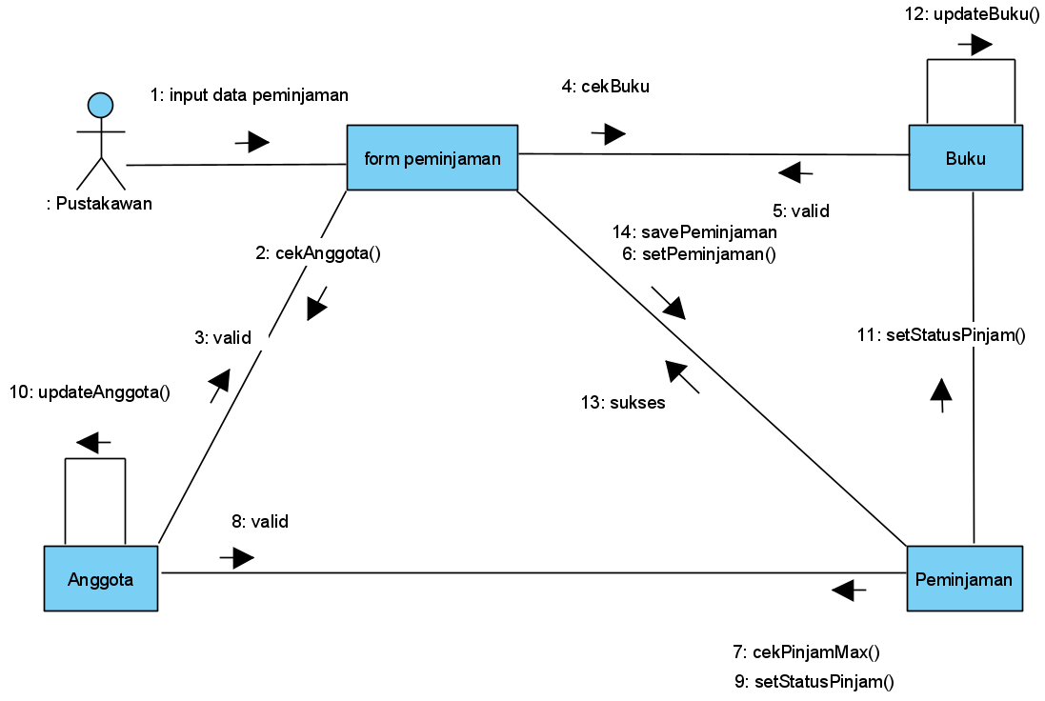
Collaboration Diagram Peminjaman buku

Slide 20
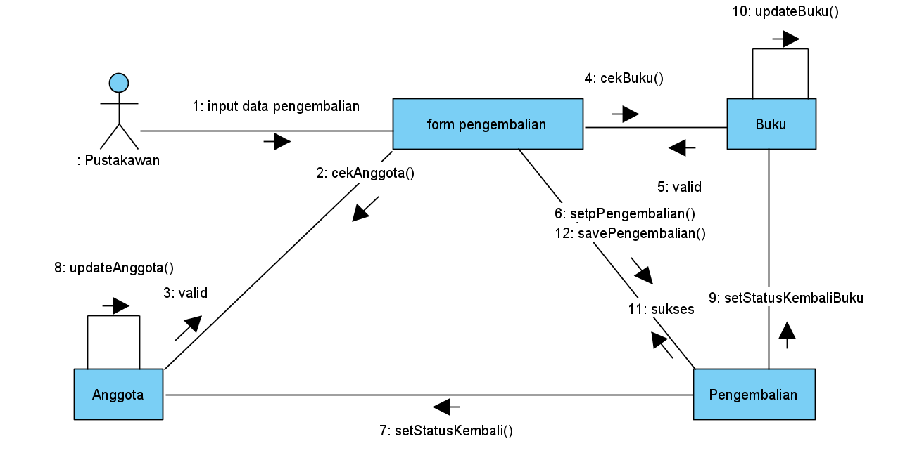
Collaboration Diagram Pengembalian buku

Slide 21
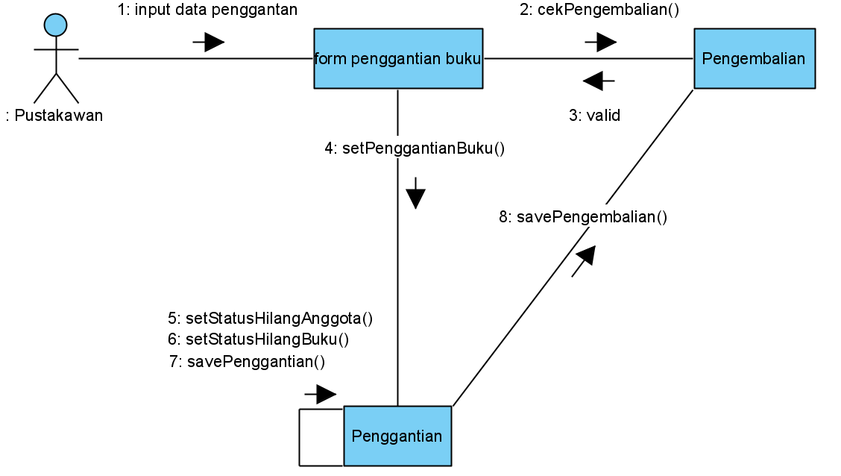
Collaboration Diagram Penggantian

Slide 22
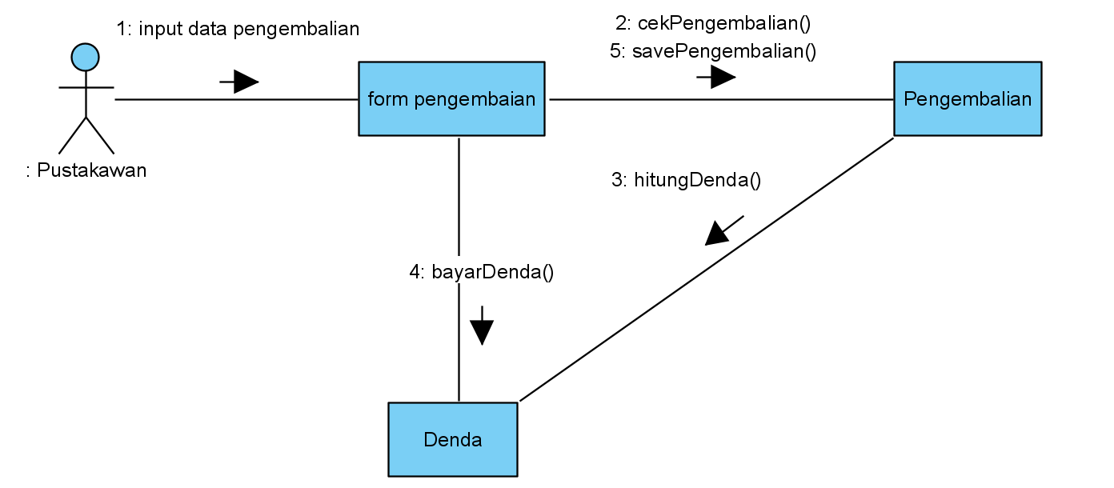
Collaboration Diagram Denda

Slide 23
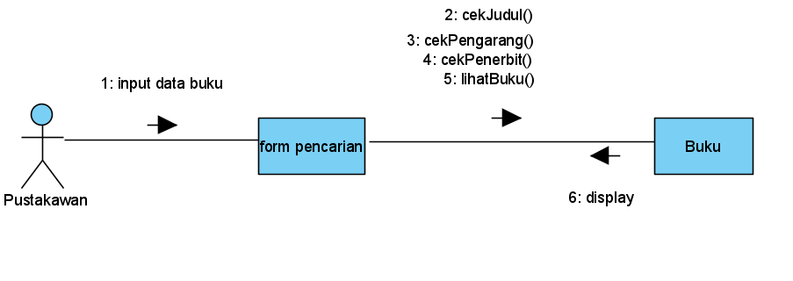
Collaboration Diagram Pencarian buku

Slide 24
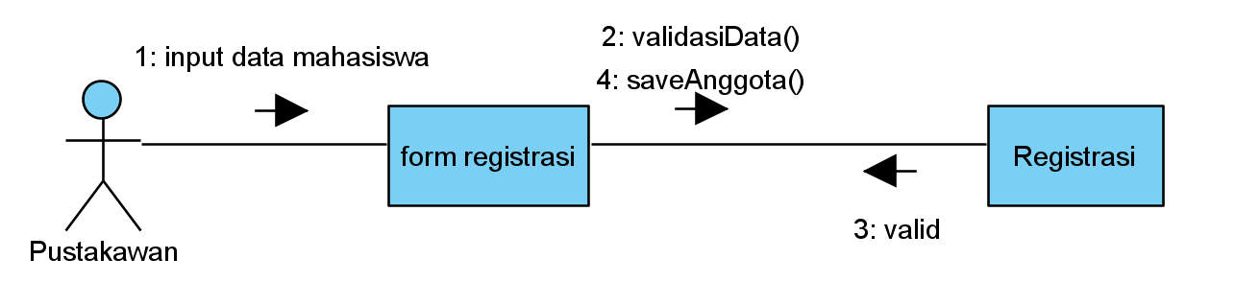
Collaboration Diagram Registrasi

Slide 25
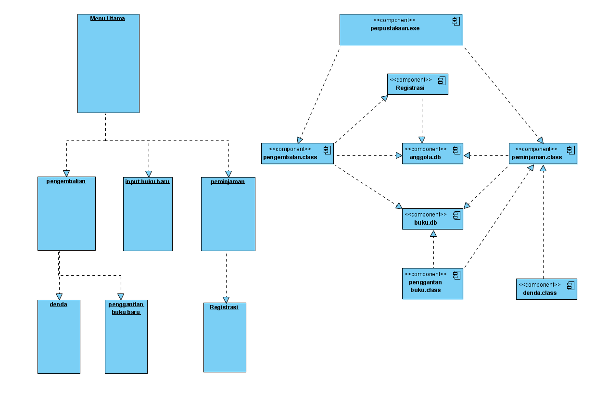
Component Diagram

Slide 26
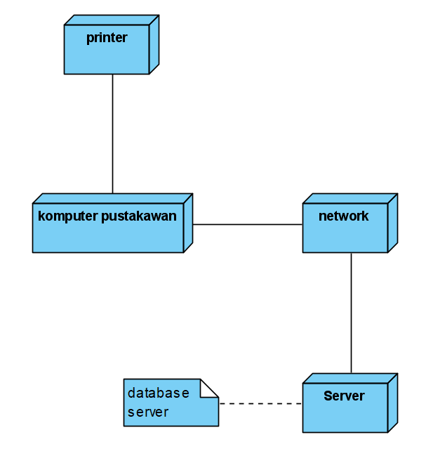
Deployment Diagram

Slide 27
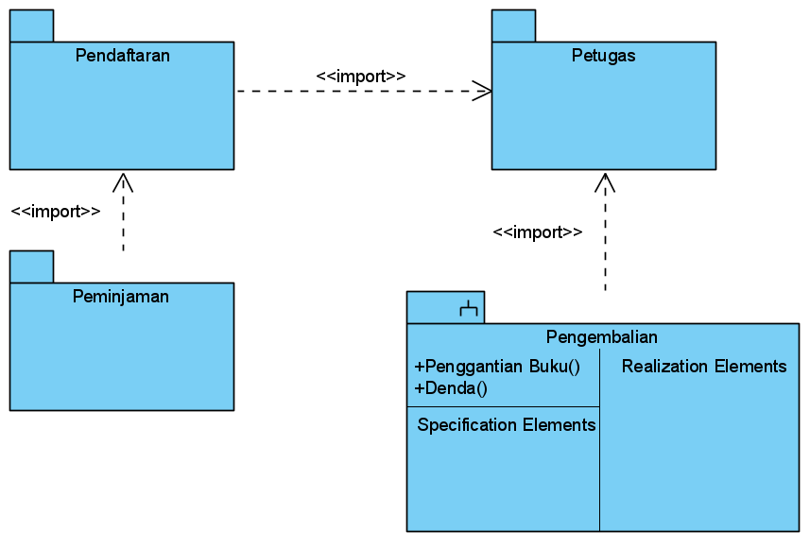
Package Diagram

Slide 28
Terima Kasih

